Slide 1
UNIT-II: Machines and Measuring Instruments
Machines: Construction, principle and operation of (i) DC Motor, (ii) DC Generator, (iii)Single Phase Transformer, (iv) Three Phase Induction Motor and (v) Alternator, Applications of electrical machines.
Measuring Instruments: Construction and working principle of Permanent Magnet MovingCoil (PMMC), Moving Iron (MI) Instruments and Wheat Stone bridge.

Slide 2
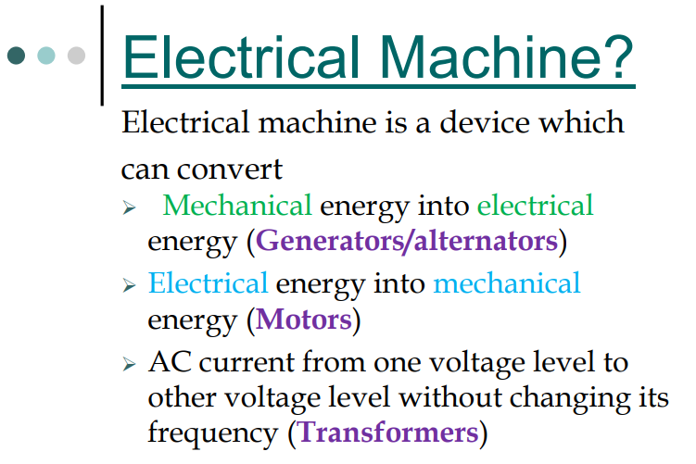

Slide 3
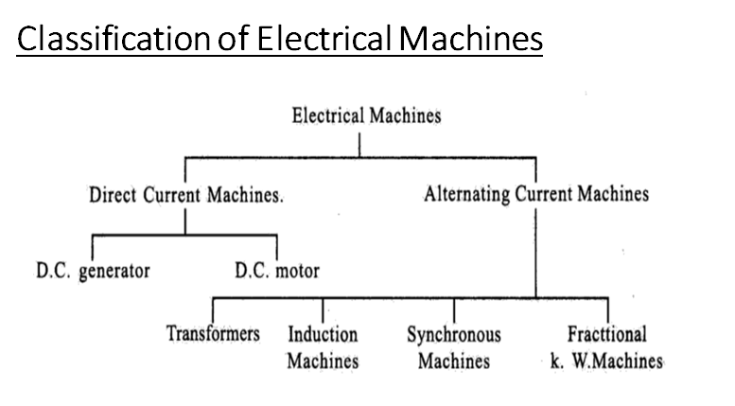

Slide 4
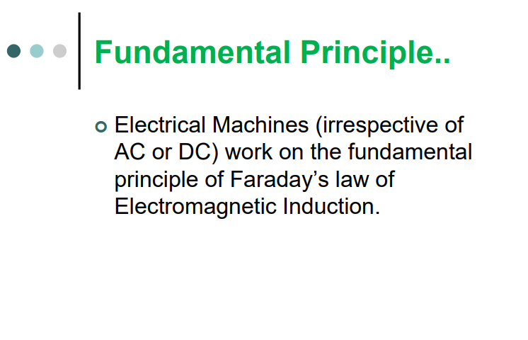

Slide 5
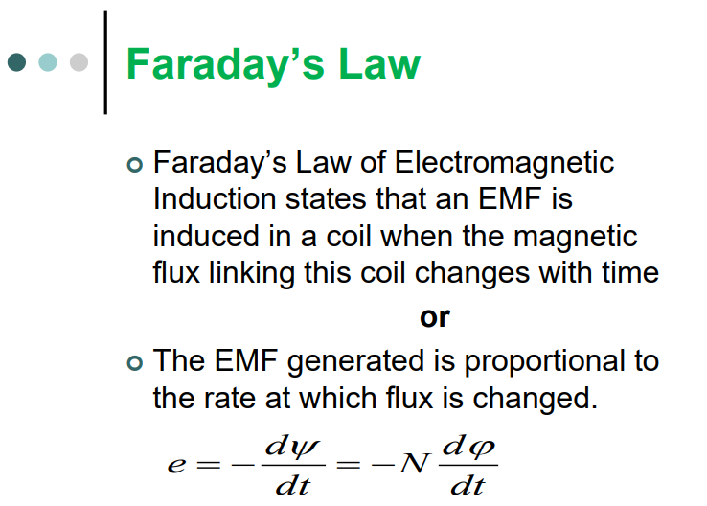

Slide 6
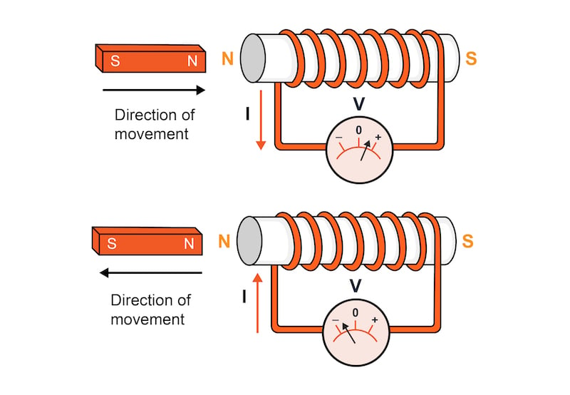

Slide 7
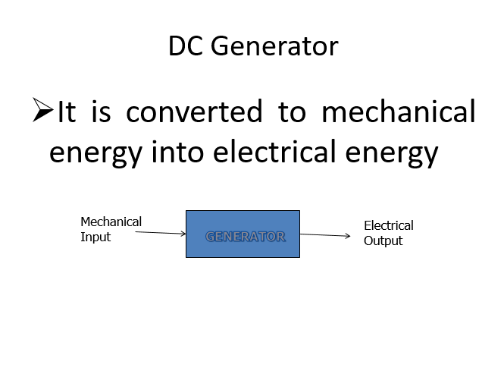

Slide 8
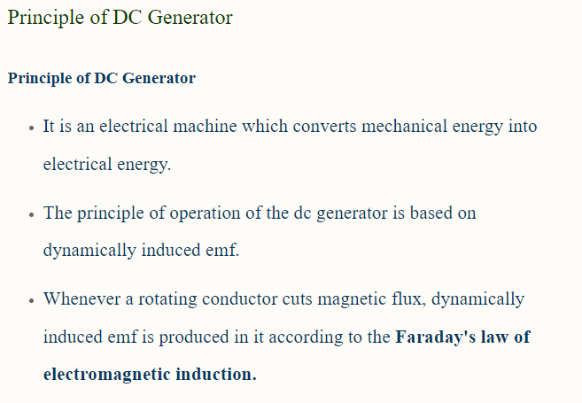

Slide 9
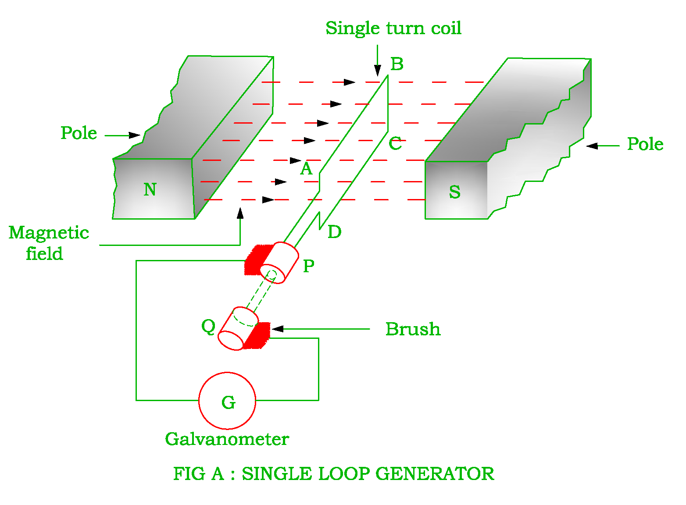

Slide 10
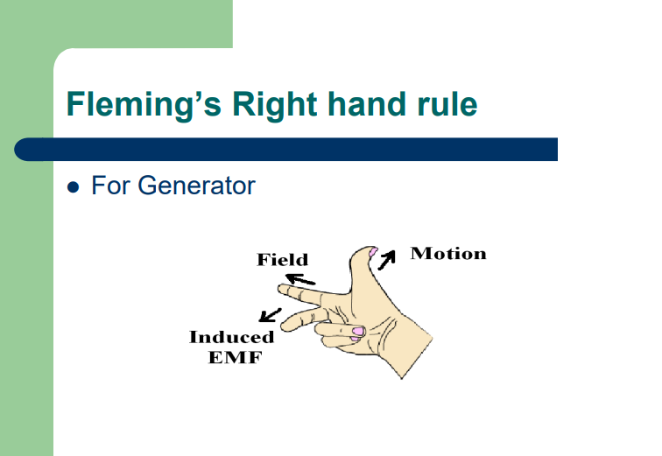

Slide 11
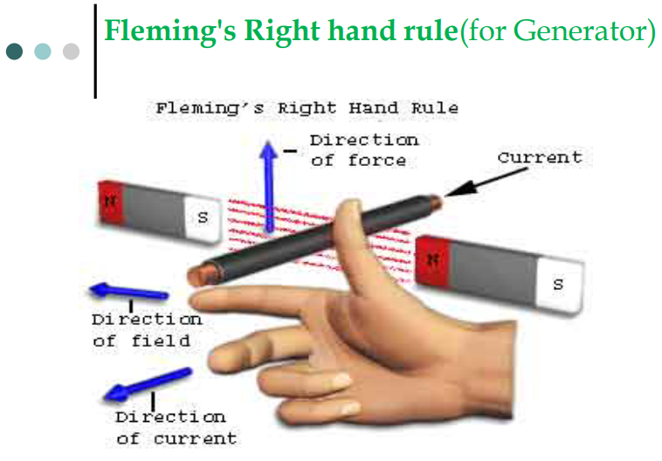

Slide 12
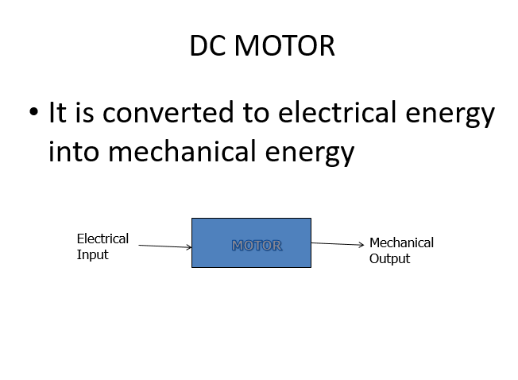

Slide 13
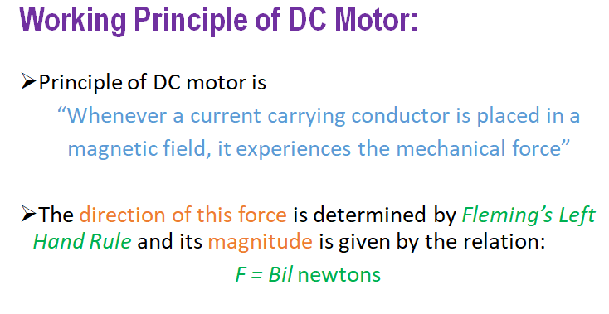
Lorentz force law

Slide 14
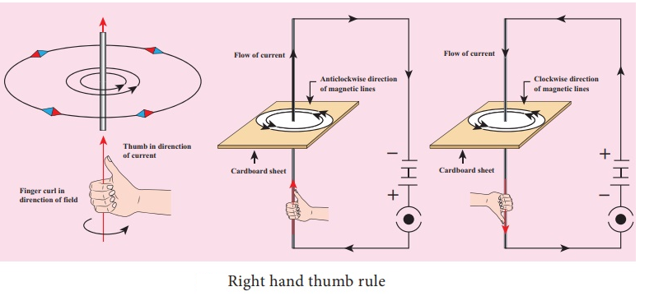

Slide 15
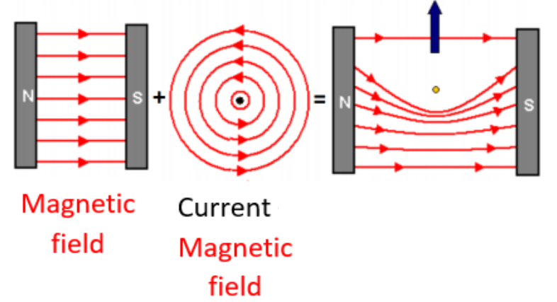
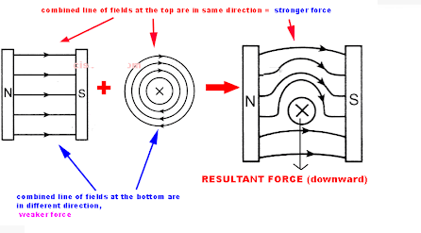

Slide 16
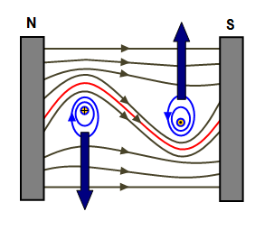

Slide 17
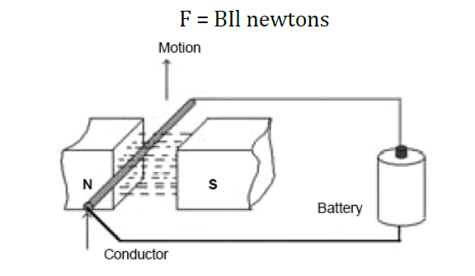
Principle of operation of DC Motor:
When a current carrying conductor is placed in a magnetic field, the conductor experiences a mechanical force.

Slide 18
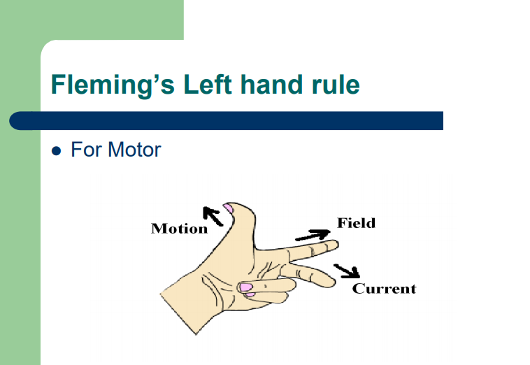

Slide 19
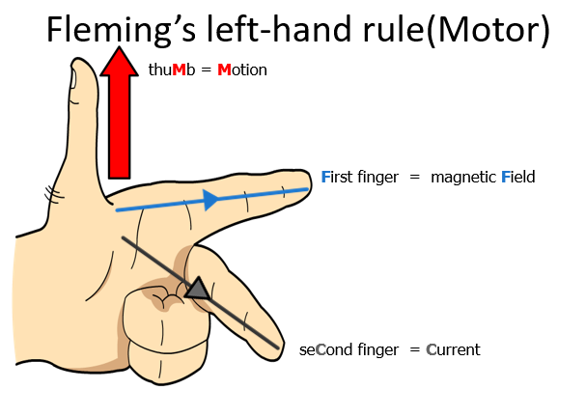

Slide 20
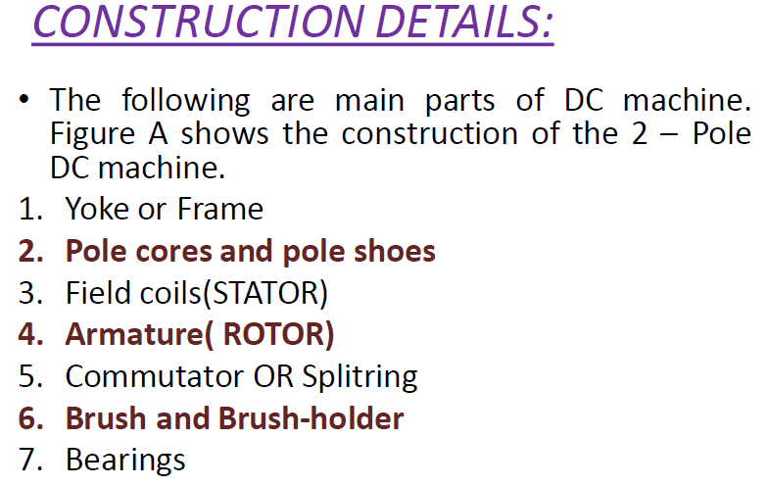

Slide 21
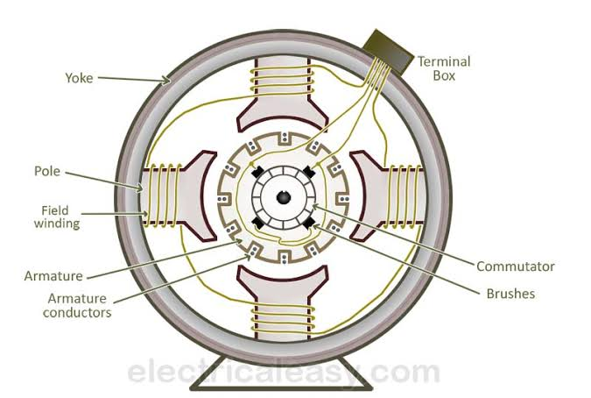

Slide 22
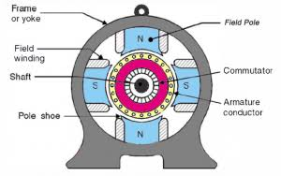

Slide 23
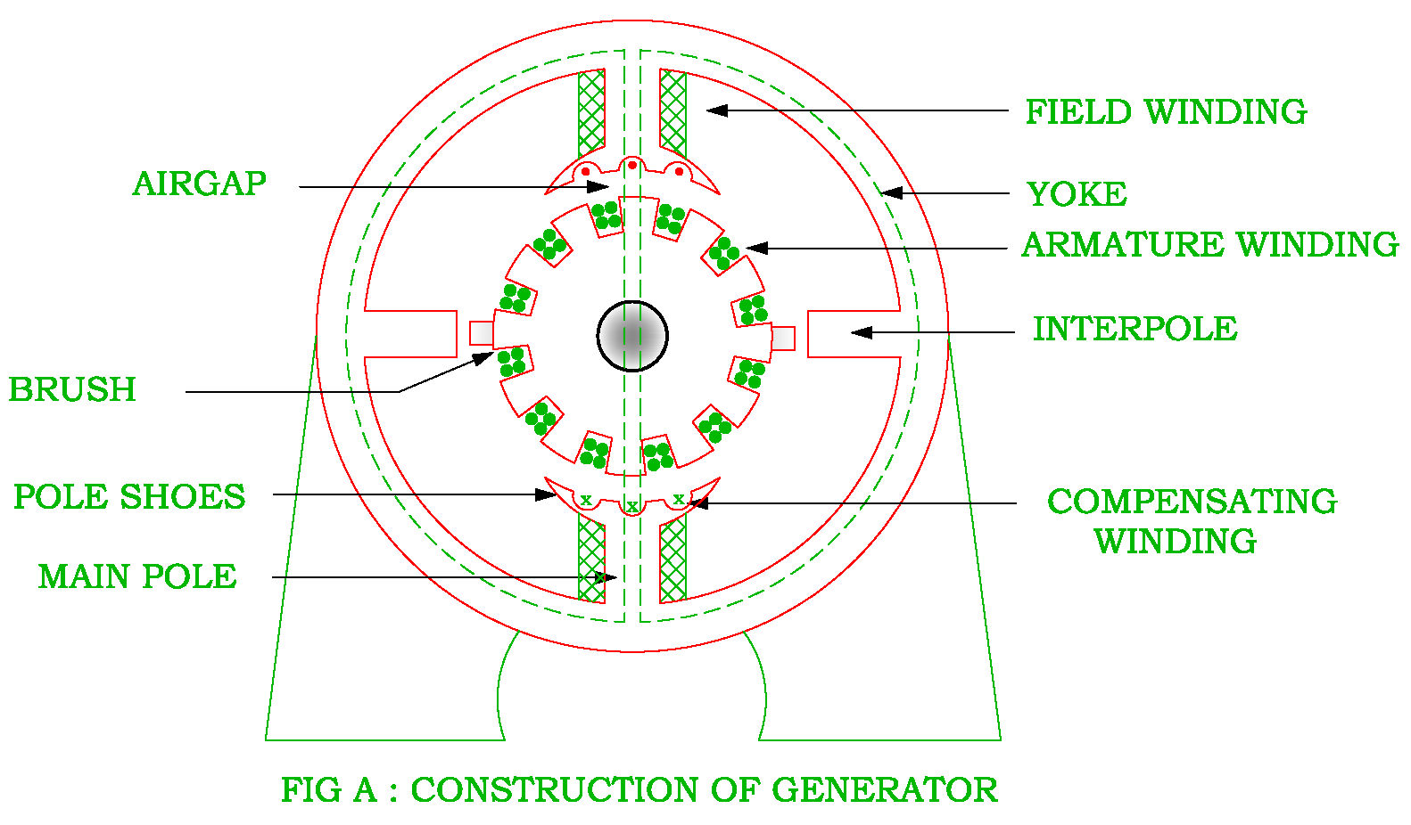

Slide 24
The function of the yoke is to
(1) Carry the magnetic flux produced by the poles
(2) To provide support for main poles and inter poles
(3) To provide protection for whole machine
The functions of the pole core is
Houses field winding
Produce required flux
The functions of the pole shoe is
(i)To Support the field winding
(ii)To spread out the flux in the air gap and also reduces the reluctance of the magnetic path.
Armature houses the armature conductors.

Slide 25
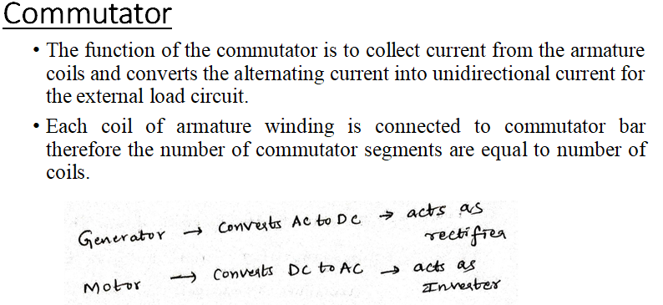


Slide 26
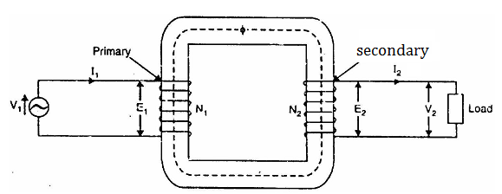
Principle of operation of Transformer
A transformer is a static piece of equipment used either for raising or lowering the voltage of an a.c. supply with a corresponding decrease or increase in current.
The working of the transformer is based on the principle of mutual inductance between two coils which are magnetic coupled.

Slide 27
If V2 > V1, it is called a step up-transformer
If V2 < V1, it is called a step-down transformer.

Slide 28
According to the principle of mutual inductance, when an alternating voltage is applied to the primary winding of the transformer, an alternating flux ϕ_{m} which is called as the mutual flux is produced in the core.
This alternating flux links both the windings magnetically and induces EMFs E₁ in the primary winding and E₂ in the secondary winding of the transformer according to Faraday’s law of electromagnetic induction.
The EMF (E₁) is called as primary EMF and the EMF (E₂) is known as secondary EMF

Slide 29
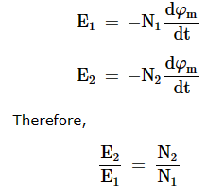

Slide 30
The following points may be noted carefully:
(i) The transformer action is based on the laws of electromagnetic induction.
(ii) There is no electrical connection between the primary and secondary. The a.c. power is transferred from primary to secondary through magnetic flux.
(iii) There is no change in frequency i.e., output power has the same frequency as the input power.
(iv) The losses that occur in a transformer are:
(a) core losses—eddy current and hysteresis losses
(b) copper losses—in the resistance of the windings

Slide 31
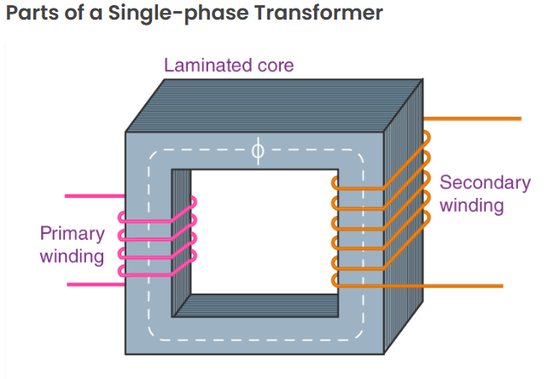

Slide 32
The major parts of a single-phase transformer consist of
1. Core
The core acts as a support to the winding in the transformer. It also provides a low reluctance path to the flow of magnetic flux.
2. Windings
Windings are the set of copper wires wound over the transformer core.
There are mainly two types of windings:
primary windings and secondary windings.
Primary winding: The set of turns of windings to which the supply current is fed.
Secondary winding: The set of turns of winding from which output is taken.
The primary and secondary windings are insulated from each other using insulation coating agents.
3. Insulation Agents
Insulation is necessary for transformers to separate windings from each other and to avoid short circuits. This facilitates mutual induction

Slide 33
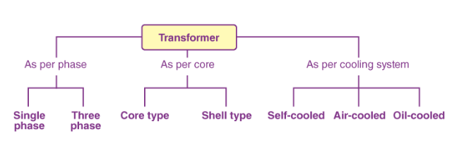

Slide 34
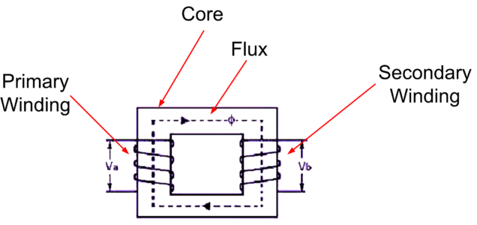
Core type Transformer:
In core type transformer, winding is positioned on two limbs of the core and there is ONLY one flux path.

Slide 35
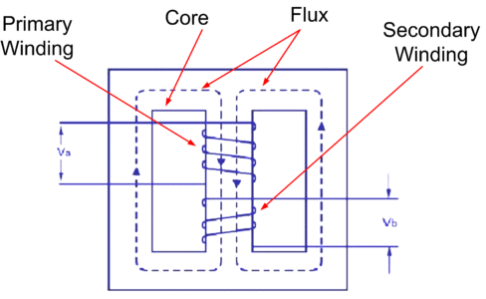
Shell Type Transformer:
In shell type transformer, winding is positioned on the middle limb of the core while other limbs are utilized as the mechanical support.

Slide 36
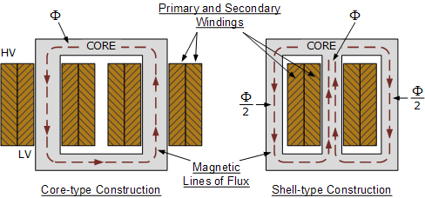

Slide 37
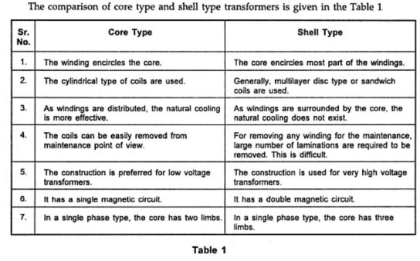

Slide 38
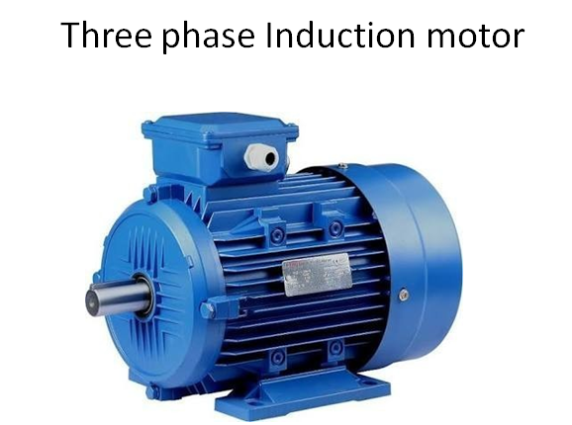

Slide 39
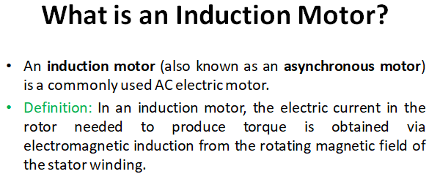

Slide 40
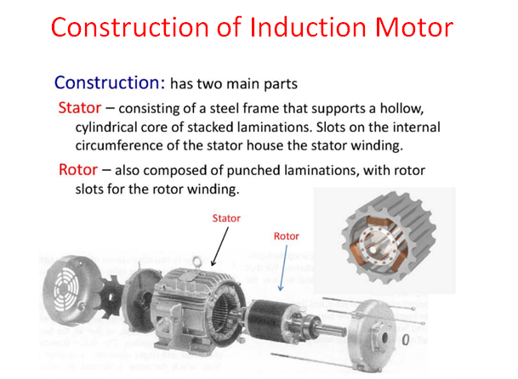

Slide 41
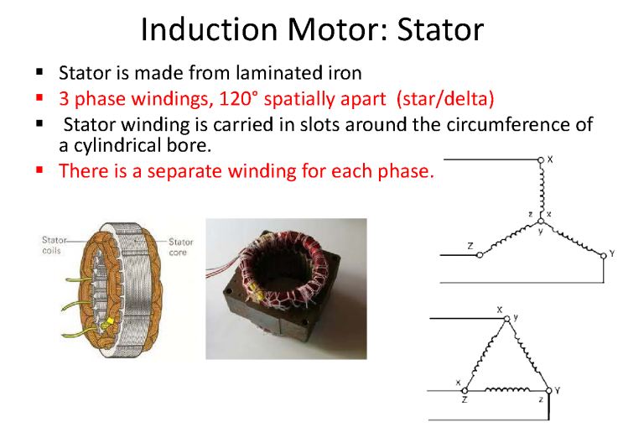

Slide 42
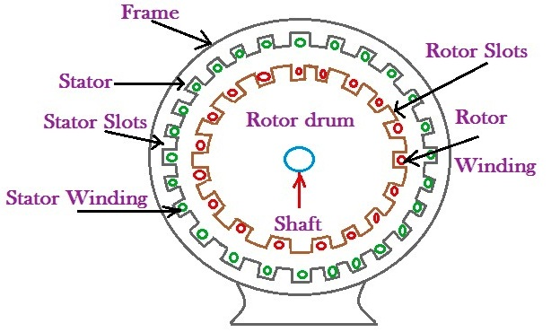

Slide 43
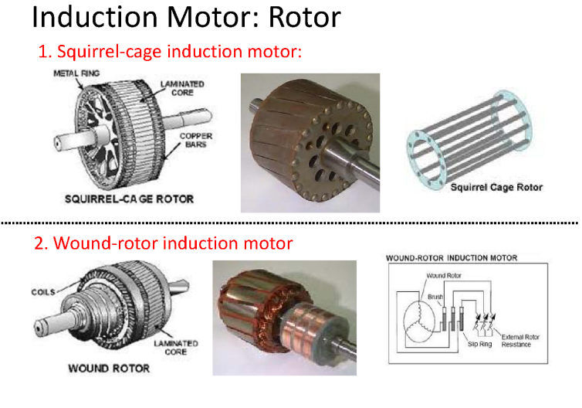

Slide 44
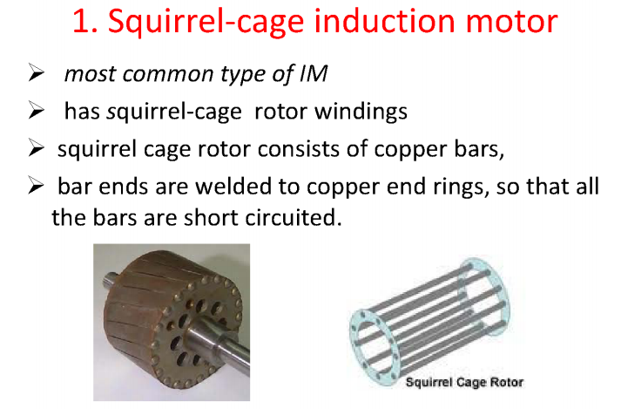

Slide 45
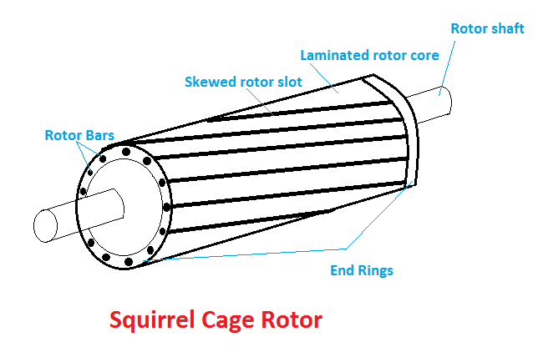

Slide 46
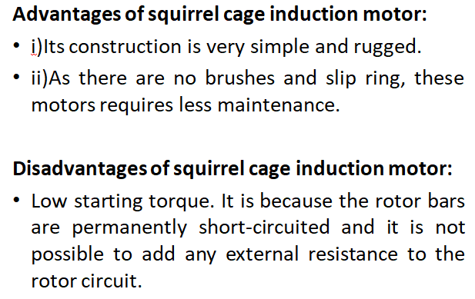

Slide 47
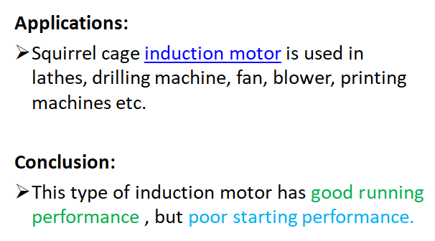

Slide 48
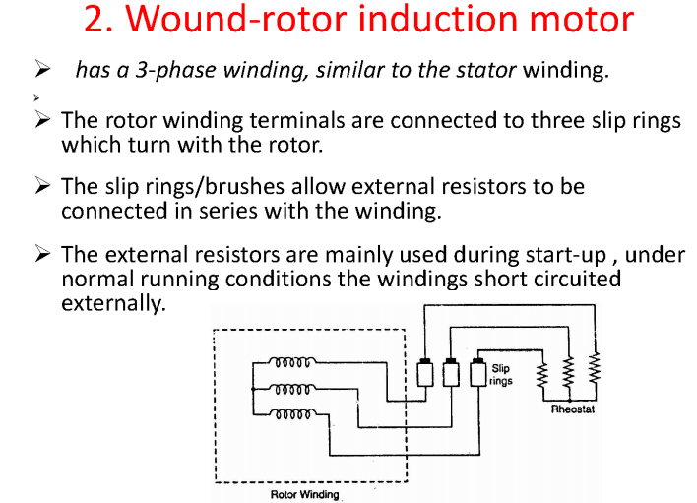

Slide 49
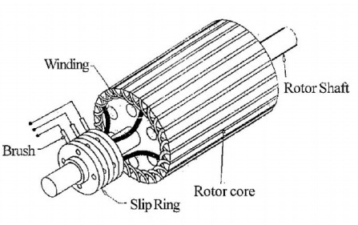

Slide 50
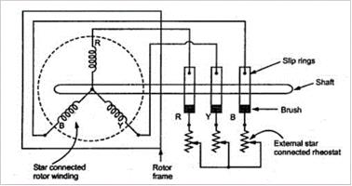

Slide 51
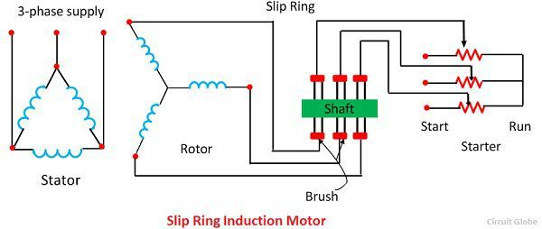

Slide 52
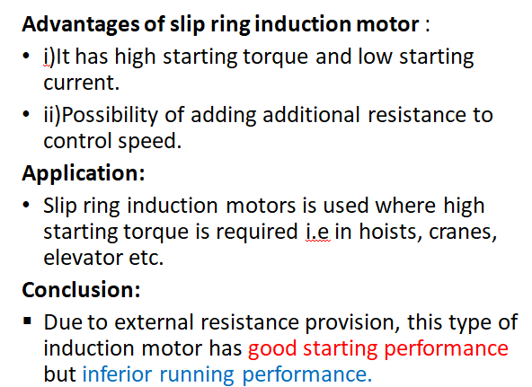

Slide 53
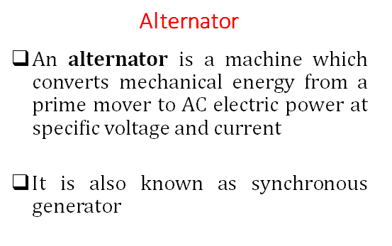

Slide 54
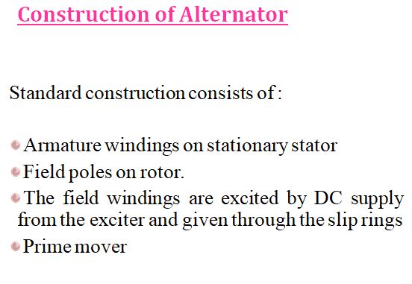

Slide 55
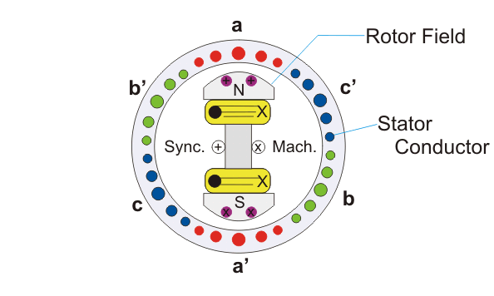

Slide 56

Construction of Stator :
The stator consists of an armature made of laminations of silicon steel having slots on its inner periphery to accommodate armature windings.

Slide 57
Construction of Rotor :
The rotor carries a field winding which is supplied with direct current through two slip rings by a separate d.c. source.
This d.c. source (called exciter) is generally a small d.c. shunt or compound generator mounted on the shaft of the alternator
Rotor construction is of two types:
(i) Salient (or projecting) pole type
(ii) Non-salient (or cylindrical) pole type

Slide 58


Slide 60


Slide 62


Slide 63
An alternator or synchronous generator works on the principle of electromagnetic induction, i.e., when the flux linking a conductor changes, an EMF is induced in the conductor.
When the armature winding of alternator subjected to the rotating magnetic field, the voltage will be generated in the armature winding.
When the rotor field winding of the alternator is energised from the DC exciter, the alternate N and S poles are developed on the rotor.
When the rotor is rotated in the anticlockwise direction by a prime mover, the armature conductors placed on the stator are cut by the magnetic field of the rotor poles.
As a result, the EMF is induced in the armature conductors due to electromagnetic induction. This induced EMF is alternating one because the N and S poles of the rotor pass the armature conductors alternatively.

Slide 64

The direction of the generated EMF can be determined by the Fleming’s right rule and the frequency of it is given by,
The magnitude of the generated voltage depends upon the speed of rotation of the rotor and the DC field excitation current. For the balanced condition, the generated voltage in each phase of the winding is the same but differ in phase by 120° electrical.

Slide 65


Slide 66


Slide 67


Slide 68


Slide 69
Measuring Instruments

Slide 70
In order to ensure proper operation of electrical indicating instruments, these torques are required.
Deflecting Torque
Controlling Torque
Damping Torque

Slide 71
Deflecting Torque:
It is the torque which deflects the pointer on a calibrated scale according to the electrical quantity passing through the instrument.
The deflecting torque causes moving system and hence pointer attached to it moves from zero position to indicate electrical quantity being measured on graduated scale.

Slide 72
Controlling Torque:
It is the torque which controls movement of the pointer on particular scale according to the quantity of electricity passing through it.
• If deflecting torque acts alone, pointer would continue to move indefinitely and would swing over to the maximum deflected position irrespective of magnitude of current (or voltage or power) to be measured.
• The controlling torque is opposite to deflecting torque. When deflecting torque equals to controlling torque, pointer comes to final steady state position.
➤ At equilibrium, Tc = TD ➤Controlling torque is provided by spring control and gravity control.

Slide 73
Spring control:
Two springs are attached on either end of spindle.
The spindle is placed in jewelled bearing, so that the frictional force between the pivot and spindle will be minimum.
Two springs are provided in opposite direction to compensate the temperature error.
The spring is made of phosphorous bronze.
When a current is supply, the pointer deflects due to rotation of the spindle. While spindle is rotate, the spring attached with the spindle will oppose the movements of the pointer.
The torque produced by the spring is directly proportional to the pointer deflection θ .
TC ∝θ

Slide 74


Slide 75
Damping Torque
This torque is used to damp out oscillation at the final steady state position. The time response of the instrument depends on damping torque.
• Under the action of deflecting torque, moving system of the instrument defects, while the controlling torque is applied on it in the opposite direction so that deflection may be proportional to the quantity under measurement.
• Under the action of these two torques the pointer oscillates at the mean position and delays to come to the final position.
• Damping torque is provided in the instrument which help the moving system of the instrument to reach to the final position at the earliest.
Damping torque is provided by following: ➤Air friction damping: It is used where low magnetic fields are produced. ➤Fluid friction damping: It is used where deflecting torque is minimum. ➤Eddy current damping: It is used where permanent magnet produces the required deflecting torque.

Slide 76
1.Air friction damping
The piston is mechanically connected to a spindle through the connecting rod .
The pointer is fixed to the spindle moves over a calibrated dial.
When the pointer oscillates in clockwise direction, the piston goes inside and the cylinder gets compressed.
The air pushes the piston upwards and the pointer tends to move in anticlockwise direction.
If the pointer oscillates in anticlockwise direction the piston moves away and the pressure of the air inside cylinder gets reduced.
The external pressure is more than that of the internal pressure. Therefore the piston moves down wards. The pointer tends to move in clock wise direction.

Slide 77


Slide 78


2.Eddy current damping

Slide 79
An aluminum circular disc is fixed to the spindle. This disc is made to move in the magnetic field produced by a permanent magnet.
When the disc oscillates it cuts the magnetic flux produced by damping magnet.
An emf is induced in the circular disc by faradays law.
Eddy currents are established in the disc since it has several closed paths.
By Lenz’s law, the current carrying disc produced a force in a direction opposite to oscillating force.
The damping force can be varied by varying the projection of the magnet over the circular disc.

Slide 80
Permanent magnet moving Coil (PMMC) Instrument:
One of the most accurate type of instrument used for D.C. measurements is PMMC instrument.
Principle of Working:
When a current-carrying conductor is placed in a magnetic field, it experiences a force and tends to move in the direction as per Fleming’s left-hand rule.

Slide 81


Slide 82
Construction:
A permanent magnet is used in this type instrument. Aluminium former is provided in the cylindrical in between two poles of the permanent magnet .
Coils are wound on the aluminium former which is connected with the spindle.
This spindle is supported with jeweled bearing.
Two springs are attached on either end of the spindle.
The terminals of the moving coils are connected to the spring. Therefore the current flows through spring 1, moving coil and spring 2.
Damping: Eddy current damping is used. This is produced by aluminium former.
Control: Spring control is used.

Slide 83
Principle of operation:
When D.C. supply is given to the moving coil, D.C. current flows through it. When the current carrying coil is kept in the magnetic field, it experiences a force.
This force produces a torque and the former rotates.
The pointer is attached with the spindle. When the former rotates, the pointer moves over the calibrated scale.
When the polarity is reversed a torque is produced in the opposite direction.
The mechanical stopper does not allow the deflection in the opposite direction. Therefore the polarity should be maintained with PMMC instrument.
If A.C. is supplied, a reversing torque is produced. This cannot produce a continuous deflection. Therefore this instrument cannot be used in A.C.

Slide 84


Slide 85


Slide 86
Moving Iron (MI) instruments:
One of the most accurate instrument used for both AC and DC measurement is moving iron instrument.
There are two types of moving iron instrument.
• Attraction type
• Repulsion type

Slide 87

1.Attraction type M.I. instrument:

Slide 88
Construction:
The moving iron fixed to the spindle is kept near the hollow fixed coil.
The pointer and balance weight are attached to the spindle, which is supported with jewelled bearing. Here air friction damping is used.
Principle of operation:
The current to be measured is passed through the fixed coil.
As the current is flow through the fixed coil, a magnetic field is produced.
By magnetic induction the moving iron gets magnetized. The north pole of moving coil is attracted by the south pole of fixed coil.
Thus the deflecting force is produced due to force of attraction.
Since the moving iron is attached with the spindle, the spindle rotates and the pointer moves over the calibrated scale.
But the force of attraction depends on the current flowing through the coil.

Slide 89
Torque developed by M.I:
Let ‘θ ’ be the deflection corresponding to a current of ‘i’ amp
Let the current increases by di, the corresponding deflection is ‘θ + dθ ’
There is change in inductance since the position of moving iron change w.r.t the fixed electromagnets.
Let the new inductance value be ‘L+dL’.
The current change by ‘di’ is dt seconds.

Slide 90


Slide 91


Slide 92



Slide 93


Slide 94

2.Repulsion type moving iron instrument:

Slide 95
Construction:
The repulsion type instrument has a hollow fixed iron attached to it. The moving iron is connected to the spindle.
The pointer is also attached to the spindle in supported with jeweled bearing.
Principle of operation:
When the current flows through the coil, a magnetic field is produced by it.
So both fixed iron and moving iron are magnetized with the same polarity, since they are kept in the same magnetic field. Similar poles of fixed and moving iron get repelled.
Thus the deflecting torque is produced due to magnetic repulsion.
Since moving iron is attached to spindle, the spindle will move.
So that pointer moves over the calibrated scale.
Damping: Air friction damping is used to reduce the oscillation.
Control: Spring control is used.

Slide 96
Wheatstone Bridge:
Wheatstone bridge, also known as the resistance bridge, calculates the unknown resistance by balancing two legs of the bridge circuit.
One leg includes the component of unknown resistance.
The Wheatstone Bridge Circuit comprises two known resistors, one unknown resistor and one variable resistor connected in the form of a bridge.
This bridge is very reliable as it gives accurate measurements.

Slide 97



Slide 98
Construction of Wheatstone Bridge:
A Wheatstone bridge circuit consists of four arms, of which two arms consist of known resistances while the other two arms consist of an unknown resistance and a variable resistance.
The circuit also consists of a galvanometer and an electromotive force source.
The emf source is attached between points a and b while the galvanometer is connected between points c and d.
The current that flows through the galvanometer depends on its potential difference.

Slide 99
Working Principle:
The Wheatstone bridge works on the principle of null deflection, i.e. the ratio of their resistances is equal, and no current flows through the circuit.
Under normal conditions, the bridge is in an unbalanced condition where current flows through the galvanometer.
The bridge is said to be balanced when no current flows through the galvanometer.
This condition can be achieved by adjusting the known resistance and variable resistance.

Slide 100


Slide 101


Slide 102
Thank You

